Slide 1
Register LC on functional image
Jin Ke

Slide 2
Before we start
These crash courses on lab wiki are very useful:
https://github.com/ycleong/MotivationCognitionLab/wiki/fmri-crashcourse#crash-course
Especially this one:
https://andysbrainbook.readthedocs.io/en/latest/fMRI_Short_Course/fMRI_Intro.html

Slide 3
Basic Idea
Final Goal: localize LC on the functional image
What we have for now:
Part of the brain anatomical image: MTC_09152021_WIP_MTC_p6a850d2k_9_1_brain.nii.gz
Whole brain anatomical image: MTC_07162021_WIP_MPRage_2_1_reoriented_brain.nii.gz
The LC location: LC.nii.gz
Whole brain functional image: example_fun.nii.gz

Slide 4
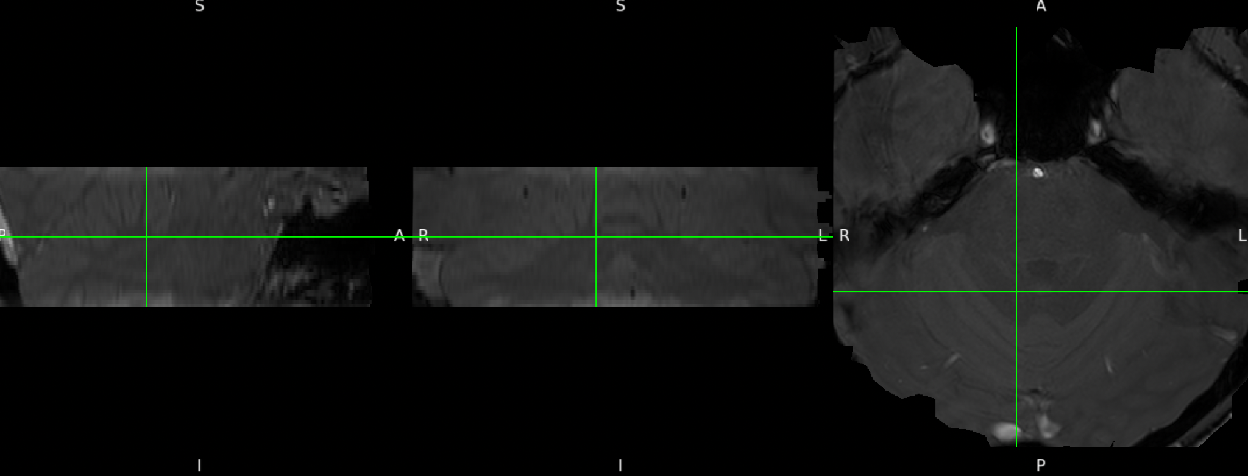
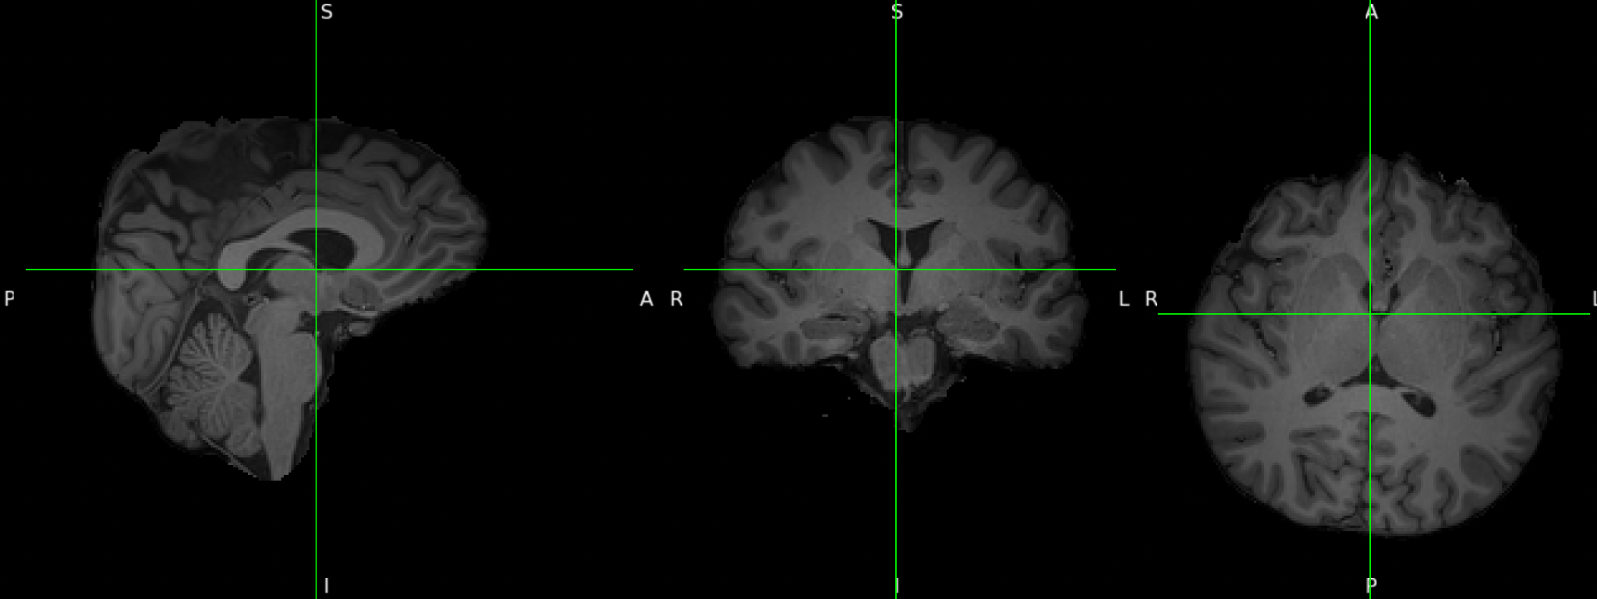
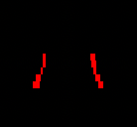
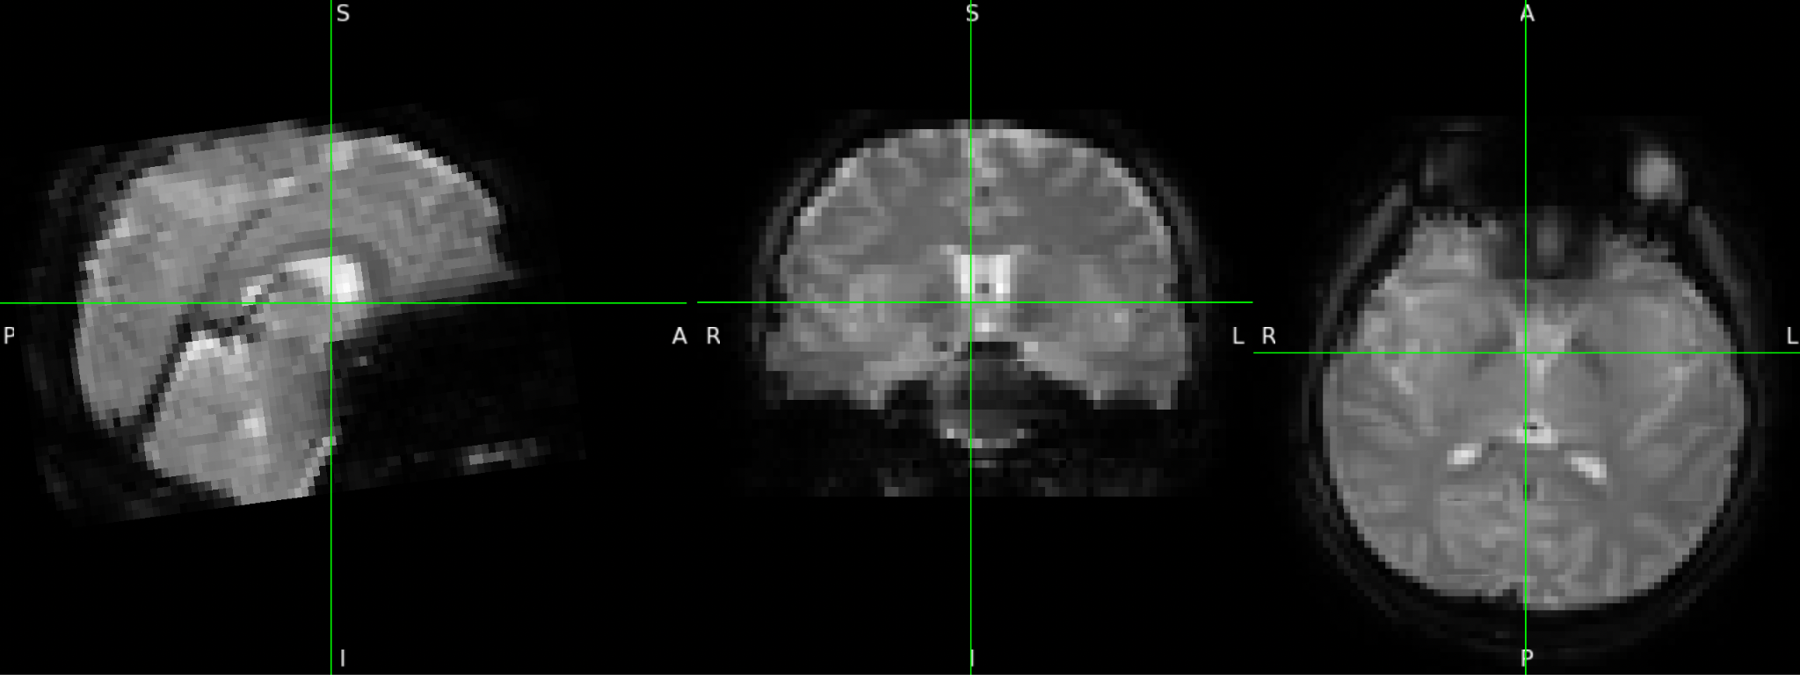
Visualization of the logic
#1 part of brain anatomical
#2 whole brain anatomical
2
3
1
#4 whole brain functional
#3 LC
Final goal
4
Step 1: Localizer LC (#3) on the part of brain anatomical (#1)
Step 2: Register part of brain anatomical (#1) to whole brain anatomical (#2)
Step 3: Register whole brain functional (#4) to whole brain anatomical (#2)
Step 4: Register LC to whole brain functional (#2)

Slide 5
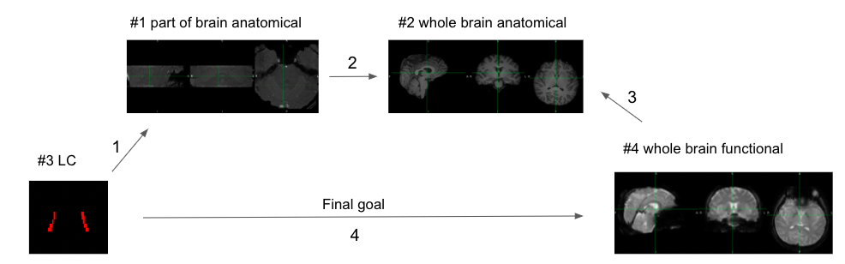
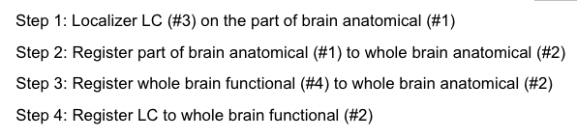
Detailed explanation of steps
Step 1: on our lab wiki
Output file: LC.nii.gz
Now you know where LC is on the part of brain anatomical (#1)

Slide 6
Detailed explanation of steps
Now you know the relative position between part of the brain anatomical (#1) and whole brain anatomical (#2)
Transformation matrix in output: MTC_09152021_WIP_MTC_p6a850d2k_9_1_brain_reg_p1.mat
Step 2: registration record here
Run this command:
/usr/local/fsl/bin/flirt -in /Users/kejin/Desktop/LC_test/MTC_09152021_WIP_MTC_p6a850d2k_9_1_brain.nii.gz -ref /Users/kejin/Desktop/LC_test/MTC_07162021_WIP_MPRage_2_1_reoriented_brain.nii.gz -out /Users/kejin/Desktop/LC_test/MTC_09152021_WIP_MTC_p6a850d2k_9_1_brain_reg_p1.nii.gz -omat /Users/kejin/Desktop/LC_test/MTC_09152021_WIP_MTC_p6a850d2k_9_1_brain_reg_p1.mat -bins 256 -cost corratio -searchrx -90 90 -searchry -90 90 -searchrz -90 90 -dof 6 -interp trilinear
Notes:
If command doesn’t work, open FLIRT GUI and try using different options
Overlay the output (brain_reg_p1) to the T1 to check if the code is working
/Users/Jadyn/fsl/bin/flirt -in /Users/Jadyn/Desktop/sub/ses/anat/MTC.nii.gz -ref /Users/…/T1.nii.gz -out /Users/…/MTC_p4.nii.gz -omat /Users/…/MTC_p4.mat -bins 256 -cost normmi -searchrx -90 90 -searchry -90 90 -searchrz -90 90 -dof 6 -interp trilinear

Slide 7
Detailed explanation of steps
Thus, combining step 1 and 2, for now you know where LC is on the whole brain anatomical (#2)
Output file: LC_reg6dof.nii
Step 2: registration record here
Then run this command:
flirt -in LC.nii.gz -ref MTC_07162021_WIP_MPRage_2_1_reoriented_brain.nii.gz -out LC_reg6dof.nii -init MTC_09152021_WIP_MTC_p6a850d2k_9_1_brain_reg_p1.mat -applyxfm
It’s applying the transformation matrix to localize LC on whole brain anatomical

Slide 8
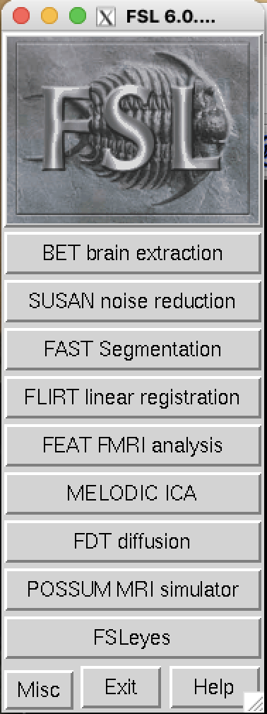
Detailed explanation of steps
Step 3: registration record here
Go to fsl: by enter fsl in terminal
Click FLIRT linear registration and follow the instructions in my document
Select example_func.nii.gz in select 4D data, you can name the run name yourself as you like

Slide 9
Detailed explanation of steps
Step 3: registration record here
Output file will be in run1.feat folder, if you name the run name run1
Search for example_func2highres.mat in run1.feat/reg
That’s the second transformation matrix

Slide 10
Detailed explanation of steps
Step 4:
Generate the inverse transformation matrix by entering this command:
convert_xfm -inverse -omat anatomical2functional.mat example_func2highres.mat
Concatenate the two matrix: part of brain anatomical to whole brain anatomical , and whole brain anatomical to functional: convert_xfm -omat LC2functional.mat -concat anatomical2functional.mat MTC_09152021_WIP_MTC_p6a850d2k_9_1_brain_reg_p1.mat
Output file: LC2functional.mat

Slide 11
Detailed explanation of steps
Step 4:
Final Step: apply the concatenated matrix to register LC onto functional image:
flirt -in LC.nii -ref MTC_07162021_WIP_rs-fMRI_7_1.nii -out LC_functional -init LC2functional.mat -applyxfm
Final Output: LC_functional.nii.gz

Slide 12
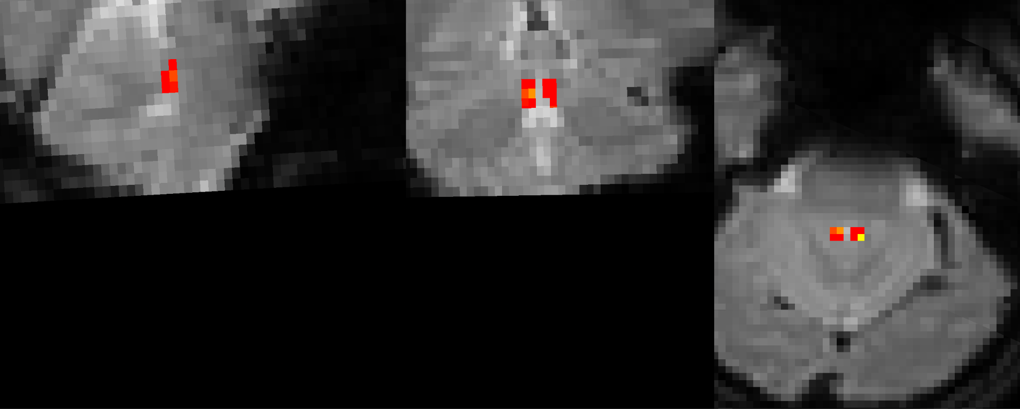
To visualize the final output in fsl
And to put the functional image in the background, you should be able to see something like this

